Slide 1
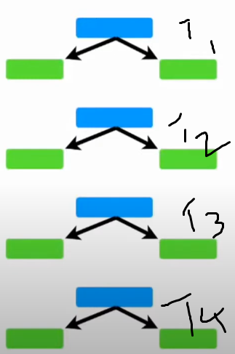
Ada Boost
AdaBoost is the first steppingstone in the world of boosting.
Adaptive Boosting is termed shortly as “Ada Boost”
Facts about AdaBoost.
AdaBoost Algorithm can be used for Regression and Classification.
AdaBoost is a forest of stump. In which, its a node with two leaves which is called as Stump. [ Random Forest is the one with no maximum depth]
How Ada Boost is different from Random Forest
AdaBoost helps you to combine multiple “Weak” to “Strong” learners. Each stump result % varies but consolidated % will be perfect.
AdaBoost can be done based on Weighted Voting or Weighted Average because some stumps will have more weightage/priority.
AdaBoost is a powerful mechanism comparing random forest since RF trees works independently. But AdaBoost will share the error details of certain samples to second tree, and it continues till the last tree.

Slide 2
AdaBoost Regressor in SkLearn
class sklearn.ensemble.AdaBoostRegressor(estimator=None, *, n_estimators=50, learning_rate=1.0, loss='linear', random_state=None)
Estimator -> If none, then it's initialized with max_depth =3.
n_estimators, default=50
learning_rate, default=1.0
loss{‘linear’, ‘square’, ‘exponential’}, default=’linear’

Slide 3
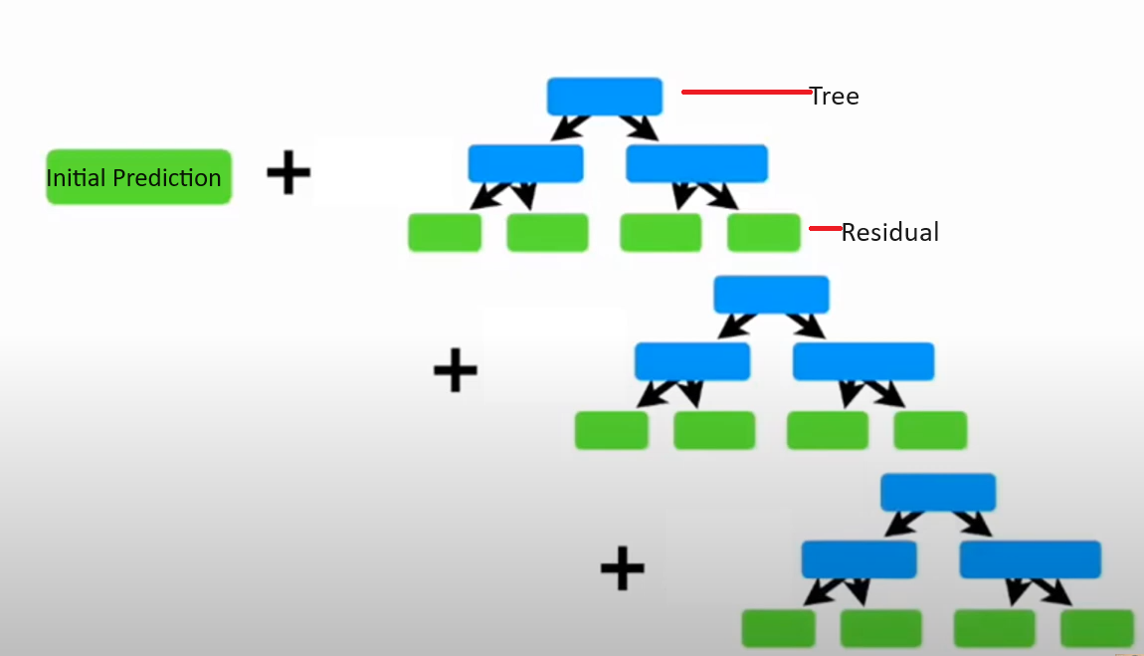
Gradient Boost
Facts about AdaBoost.
Gradient Boosting can be used for Regression and Classification.
Results from Gradient Boosting are obtained with least squares loss and 500 regression trees of depth 4
Gradient Boosting basics is Residual learning process

Slide 4
Gradient Regressor in SkLearn
Load the Data
diabetes = datasets.load_diabetes()
X, y = diabetes.data, diabetes.target
Data preprocessing – (90% as Train and Remaining as Test)
n_estimators : the number of boosting stages that will be performed. Later, we will plot deviance against boosting iterations.
max_depth : limits the number of nodes in the tree. The best value depends on the interaction of the input variables.
min_samples_split : the minimum number of samples required to split an internal node.
learning_rate : how much the contribution of each tree will shrink.
loss : loss function to optimize. The least squares function is used in this case however, there are many other options.
X_train, X_test, y_train, y_test = train_test_split( X, y, test_size=0.1, random_state=13 ) params = { "n_estimators": 500, "max_depth": 4, "min_samples_split": 5, "learning_rate": 0.01, "loss": "squared_error", }
Fit regression model
reg = ensemble.GradientBoostingRegressor(**params)
reg.fit(X_train, y_train)
mse = mean_squared_error(y_test, reg.predict(X_test))
print("The mean squared error (MSE) on test set: {:.4f}".format(mse))
Plot training deviance – To Visualize the results. First compute the test set deviance and then plot it against boosting iterations.

Slide 5
XG Boosting
XGBoost is a powerful approach for building supervised regression models.
Validity of this statement can be inferred by knowing about its (XGBoost) objective function and base learners.
The objective function contains loss function and a regularization term. It tells about the difference between actual values and predicted values.
The most common loss functions in XGBoost for regression problems is reg:linear, and that for binary classification is reg:logistics.
Ensemble learning involves training and combining individual models (known as base learners) to get a single prediction.
XGBoost is one of the ensemble learning methods.
XGBoost expects to have the base learners which are uniformly bad at the remainder so that when all the predictions are combined, bad predictions cancels out and better one sums up to form final good predictions.

Slide 6
# Necessary imports
import numpy as np
import pandas as pd
import xgboost as xg
from sklearn.model_selection import train_test_split
from sklearn.metrics import mean_squared_error as MSE
# Load the data
dataset = pd.read_csv(#Input File)
X, y = dataset.iloc[:, :-1], dataset.iloc[:, -1]
# Splitting
train_X, test_X, train_y, test_y = train_test_split(X, y, test_size = 0.3, random_state = 123)
# Instantiation
xgb_r = xg.XGBRegressor(objective ='reg:linear', n_estimators = 10, seed = 123)
# Fitting the model
xgb_r.fit(train_X, train_y)
# Predict the model
pred = xgb_r.predict(test_X)
# RMSE Computation
rmse = np.sqrt(MSE(test_y, pred))
print("RMSE : % f" %(rmse))

